Slide 1
Collective Spammer Detection in Evolving Multi-Relational Social Networks
Speaker: Jim-An Tsai
Advisor: Professor Jia-ling Koh
Author:Shobeir Fakhraei, James Foulds, Lise Getoor, Madhusudana Shashanka
Date:2016/8/16
Source: KDD ’15

Slide 2
OUTLINE
Introduction
Method
Experiment
Conclusion

Slide 3
Introduction
Notes:
http://www.tagged.com/profile.html?dataSource=Profile&ll=nav

Slide 4
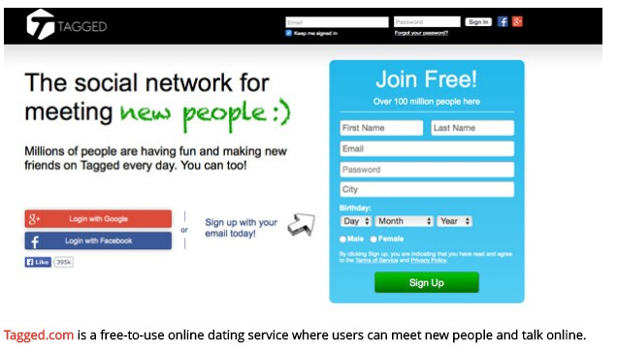
Introduction

Slide 5
Introduction

Slide 6
Framework
Users’ files
from Tagged.com
Graph Structure Features
Sequence-Based Features
Collective Classification with Reports
Spammer or not

Slide 7
OUTLINE
Introduction
Method
Experiment
Conclusion

Slide 8
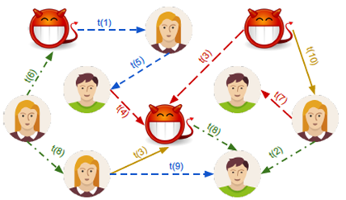
Graph Structure Features
Our goal is to capture the structural differences between spammers' and
legitimate users' multi-relational neighborhood graph.
Notes:
https://turi.com/products/create/

Slide 9
Graph Structure Features
1. PageRank
2. Degree
3. k-core
4. Graph Coloring
5. Connected Components
6. Triangle Count

Slide 10
Sequence-Based Features
Provide two different solutions for classifying users based on their activity sequences.
1. Sequential k-gram Features
2. Mixture of Markov Models

Slide 11
Sequential k-gram Features
Represent a sequence with features is to treat each element in the sequence as a feature independently.

Slide 12
Mixture of Markov Models
Notes:
http://www.csie.ntnu.edu.tw/~u91029/HiddenMarkovModel.html 馬可夫

Slide 13
Collective Classification with Reports
Using Hinge-loss Markov Random Fields(HL-MRFs) to assign credibility scores to the users offering feedback via the reporting system.
Probabilistic Soft Logic (PSL) uses a first-order logical syntax as a templating language for HL-MRFs.
Notes:
http://stephenbach.net/files/bach-uai13.pdf
http://psl.umiacs.umd.edu/ PSL

Slide 14
HL-MRFs Collective Model for Reports
Notes:
http://web.thu.edu.tw/s994928/www/File/note/1001dismath.pdf

Slide 15
OUTLINE
Introduction
Method
Experiment
Conclusion

Slide 16
Data

Slide 17
Graph Structure Features

Slide 18
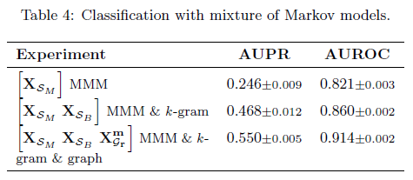
Sequence-based Features

Slide 19
Experiment

Slide 20
Collective Classification with Reports

Slide 21
Collective Classification with Reports

Slide 22
OUTLINE
Introduction
Method
Experiment
Conclusion

Slide 23
Conclusion
This paper develops methods to identify spammers in evolving multi-relational social networks.
Show that models which incorporate the multi-relational nature of the social network significantly gain predictive performance over those that do not.

